Slide 1
Azure - Day 2 Epam DevOps School
Data protection
Azure Storage
Governance
CONFIDENTIAL | © 2020 EPAM Systems, Inc.

Slide 2
AZ-103T00A Module 07: Data Protection

Slide 3
Module Overview
Data Replication
File and Folder Backups
Virtual Machine Backups
Lab and Review Questions
Notes:
Module overview

Slide 4
Lesson 01: Data Replication

Slide 5
Data Replication Overview
Locally-redundant Storage
Zone-redundant Storage
Geo-redundant Storage
Geo-zone-redundant Storage
Comparing Replication Strategies
Notes:
Lesson overview

Slide 6
Locally-redundant Storage
Replication | Copies | Strategy
Locally redundant storage (LRS) | Maintains three copies of your data. | Data is replicated three time within a single facility in a single region.
Lowest cost option
Use if data can be easily reconstructed
Use if data is “live” and does not require storage
Use if there are regional governance requirements

Slide 7
Zone-redundant Storage
Replication | Copies | Strategy
Zone-redundant storage (ZRS) | Maintains three copies of your data. | Data is replicated across three storage clusters in a single region.
Replicates your data across three storage clusters in a single region
Each storage cluster is physically separated from the others and resides in its own availability zone
Each availability zone, and the ZRS cluster within it, is autonomous, with separate utilities and networking capabilities
Consistency, durability, and high availability scenarios
Notes:
✔️Consider ZRS for scenarios that require strong consistency, strong durability, and high availability even if an outage or natural disaster renders a zonal data center unavailable.

Slide 8
Geo-redundant Storage
Replication | Copies | Strategy
Geo-redundant storage (GRS) | Maintains six copies of your data. | Data is replicated three times within the primary region and is also replicated three times in a secondary region.
Read access geo-redundant storage (RA-GRS) | Maintains six copies of your data. | Data is replicated to a secondary geographic location and provides read access to your data in the secondary location.
GRS replicates your data to another data center in a secondary region, but that data is available to be read only during a failure
RA-GRS is based on GRS and replicates data to another data center in another region. Provides read access from the secondary region, even without a failure
Consider the Recovery Time Objective and Recovery Point Objective
Notes:
✔️ If you enable RA-GRS and your primary endpoint for the Blob service is myaccount.blob.core.windows.net, then your secondary endpoint is myaccount-secondary.blob.core.windows.net. The access keys for your storage account are the same for both the primary and secondary endpoints.

Slide 9
Geo-zone-redundant Storage
Replication | Strategy
Geo-zone-redundant storage (GZRS) | Data is replicated across three Azure availability zones in the primary region and replicated to a secondary geographic region for protection from regional disasters.
Read access geo-zone-redundant storage (RA-GZRS) | Enables read access to data in the secondary GZRS region.
Combines the features of ZRS with GRS
Consistency, durability, high availability, excellent performance, and resilience for disaster recovery
Notes:
Feature is in preview – Oct 2019.

Slide 10
Comparing Replication Strategies
Replication Option | LRS | ZRS | GRS/RA-GRS | GZRS/RA-GZRS
Node unavailability within a data center | Yes | Yes | Yes | Yes
An entire data center (zonal or non-zonal) becomes unavailable | No | Yes | Yes | Yes
A region-wide outage | No | No | Yes | Yes
Read access to your data (in a remote, geo-replicated region) for region-wide unavailability | No | No | Yes (with RA-GRS) | Yes (with RA-GZRS)
Available in storage account types | GPv1, GPv2, Blob | GPv2 | GPv1, GPv2, Blob | GPv1, GPv2, Blob

Slide 11
Lesson 02: File and Folder Backups

Slide 12
File and Folder Backups Overview
Azure Backup
Recovery Service Vault Backup Options
Demonstration – Backup Azure File Shares
Implementing On-Premises File and Folder Backups
Microsoft Azure Recovery Services (MARS) Agent
Demonstration – Backup Files and Folders
Notes:
Lesson overview

Slide 13
Azure Backup
Azure-based service used to back up and restore data in Microsoft cloud
Automatic Storage Management
Multiple storage options
Unlimited data transfer
Data encryption
Application consistent backup
Long-term retention
Notes:
✔️ What are some of the reasons your organization might choose Azure Backup?
For more information, you can see:
Why use Azure Backup? - https://docs.microsoft.com/en-us/azure/backup/backup-introduction-to-azure-backup#why-use-azure-backup

Slide 14
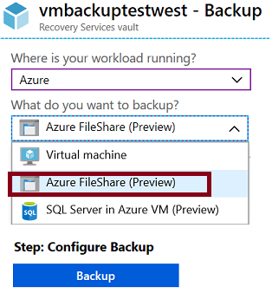
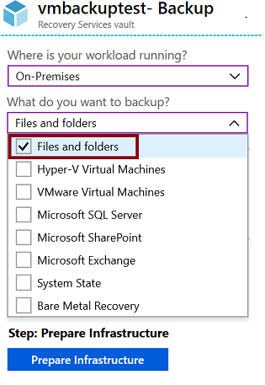
Recovery Services Vault Backup Options
Azure Workloads
On-Premises workloads
Notes:
Focus on the choices when you select Azure or On-Premises and want to backup files and folders.
✔️ Within an Azure subscription, you can create up to 25 Recovery Services vaults per region.
✔️ Notice your backup choices for virtual machines. This will be covered in another lesson.

Slide 15
Demonstration – Backup Azure File Shares
Create a Recovery Services vault
Configure the vault
Explore monitoring information

Slide 16
Implementing On-Premises File and Folder Backup
Create the recovery services vault
Download the agent and credential file
Install and register agent
Configure the backup

Slide 17
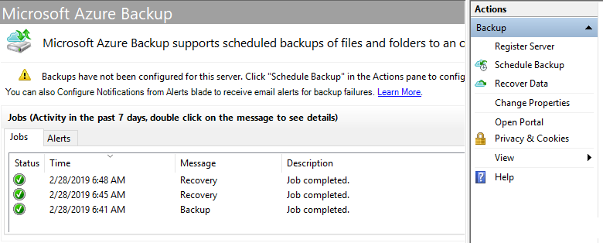
MARS Agent
Backup or recover files and folders on physical or virtual Windows OS (VMs can be on-premises or in Azure)
No separate backup server required
Not application aware; file, folder, and volume-level restore only
No support for Linux

Slide 18
Demonstration – Backup Files and Folders
Create a Recovery Services vault
Configure the vault
Install and register the agent
Create the backup policy
Backup files and folders
Explore the recover settings
Explore the backup properties
Delete your backup schedule

Slide 19
Lesson 03: Virtual Machine Backups

Slide 20
Virtual Machine Backups Overview
Azure Site Recovery (ASR) Scenarios
Virtual Machine Data Protection
Workload Protection Needs
Azure to Azure Architecture
Recovery Services Vault VM Backup Options
Implementing VM Backups
Implementing VM Restore
Azure Backup Server
Backup Component Comparison
Notes:
Lesson overview

Slide 21
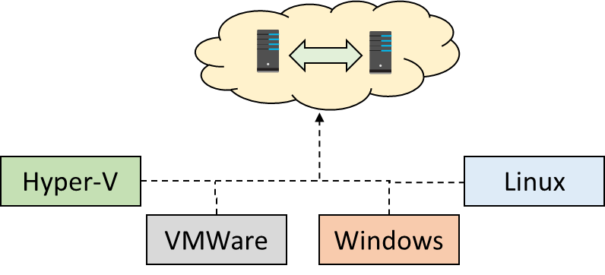
Azure Site Recovery (ASR) Scenarios
Replicate Azure VMs from one Azure region to another
Replicate on-premises VMware VMs, Hyper-V VMs, physical servers (Windows and Linux), Azure Stack VMs to Azure
Replicate on-premises VMware VMs, Hyper-V VMs managed by System Center VMM, and physical servers to a secondary site
Notes:
We will concentrate on replication within Azure and not migration scenarios from on-premises.

Slide 22
Virtual Machine Data Protection
Managed snapshots provide a quick and simple option for backing up VMs that use Managed Disks
Azure Backup supports application-consistent backups for both Windows and Linux VMs
Azure Site Recovery protects your VMs from a major disaster scenario when a whole region experiences an outage
Notes:
✔️ Have you tried any of these backup methods? Do you have a backup plan?

Slide 23
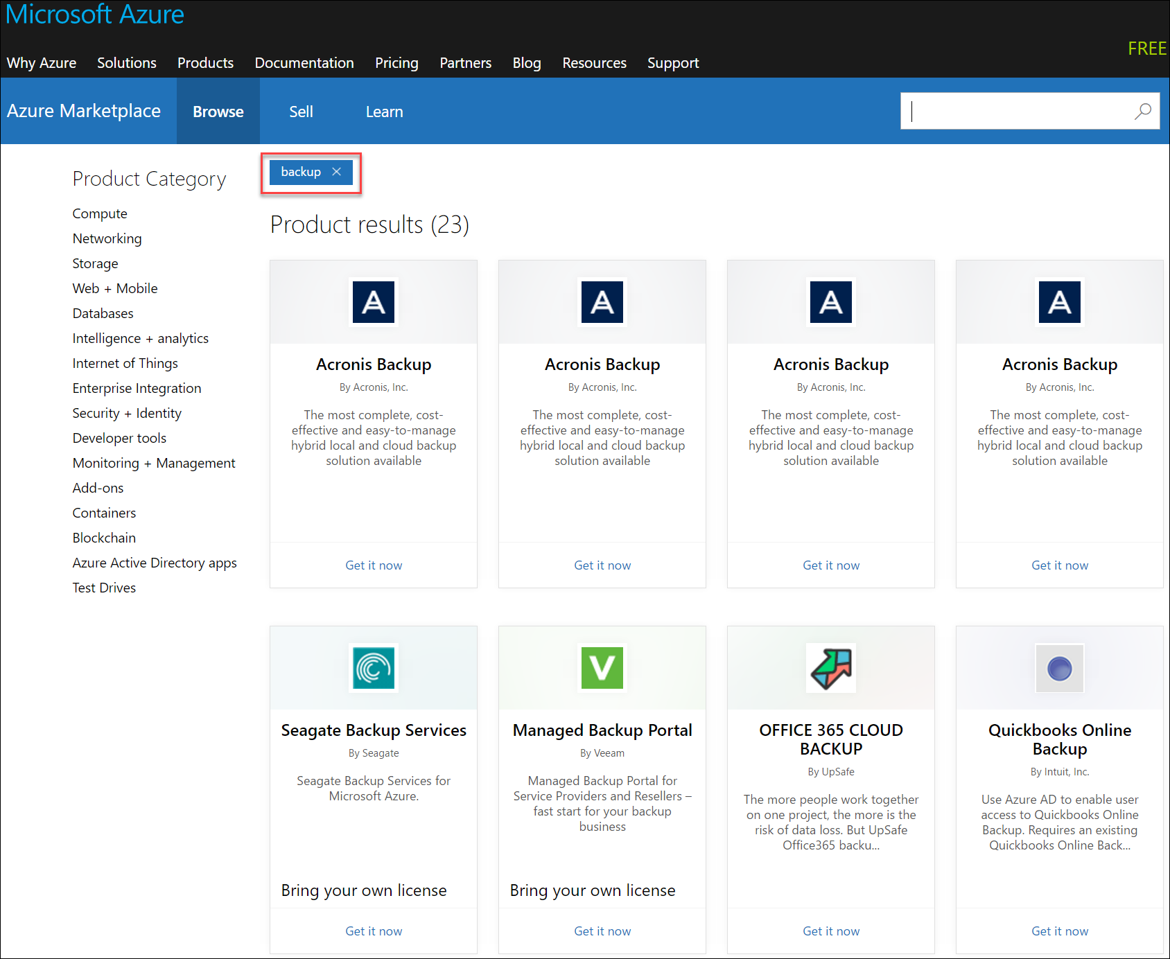
Workload Protection Needs
Many backup options are available
How the workload is being protected today?
How often is the workload is backed up?
What types of backups are being done?
Is disaster recovery protection in place?

Slide 24
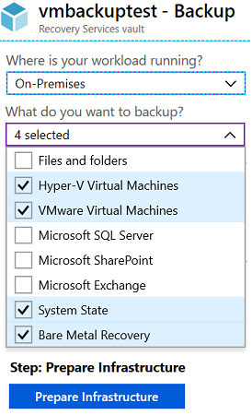
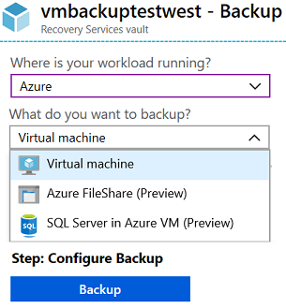
Recovery Services Vault VM Backup Options
Azure Workloads
On-Premises Workloads
✔️ Multiple servers can be protected using the same Recovery Services vault
Notes:
Focus on the choices when you select Azure or On-Premises and want to backup virtual machines.

Slide 25
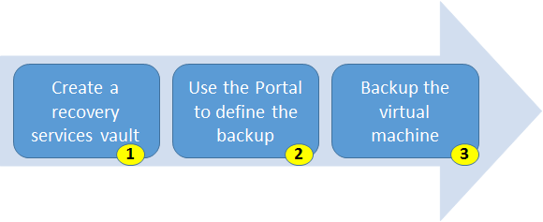
Implementing VM Backups
Use a Recovery Services vault in the region where you want to store the data To backup your files and folders. Also determine how you want your storage replicated.
Take snapshots (recovery points) of your data at defined intervals. These snapshots are stored in recovery services vaults.
For the Backup extension to work, the Azure VM Agent must be installed on the Azure virtual machine.
Notes:
For more information, you can see:
Plan your VM backup infrastructure in Azure - https://docs.microsoft.com/en-us/azure/backup/backup-azure-vms-introduction

Slide 26
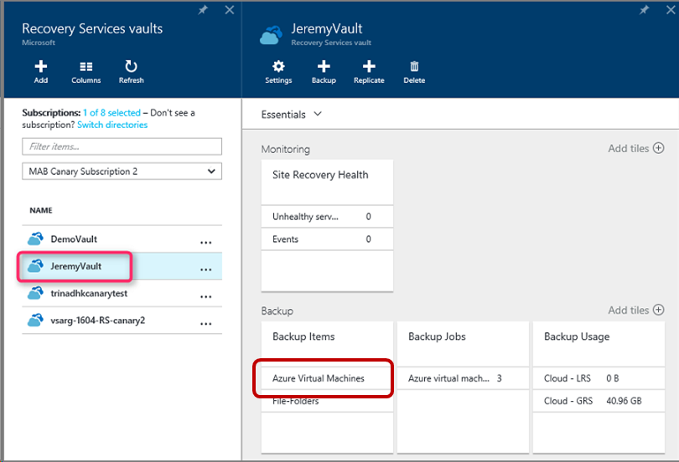
Implementing VM Restore
Once you trigger the restore operation, the Backup service creates a job for tracking the restore operation
The Backup service also creates and temporarily displays notifications, so you monitor how the backup is proceeding

Slide 27

Azure Backup Server
Specialized Workloads
Virtual Machines
Files/Folders/Volumes
Azure
System Center DPM
Or Azure Backup Server
App-aware backups, file/folder/volume backups, and machine state backups (bare-metal, system state)
Each machine runs the DPM/MABS protection agent, and the MARS agent runs on the MABS/DPM
Flexibility and granular scheduling options
Manage backups for multiple machines in a protection group

Slide 28
Backup Component Comparison
Component | Benefits | Limits | Protects | Backup Storage
Azure Backup (MARS) agent | Backup files and folders on physical or virtual Windows OS No separate backup server required. | Backup 3x per day Not application aware File, folder, and volume-level restore only No support for Linux | Files Folders | Recovery services vault
Azure Backup Server | App aware snapshots Full flex for when to backups Recovery granularity Linux support on Hyper-V and VMware VMs Backup and restore VMware VMs Doesn't require a System Center license | Cannot backup Oracle workloads Always requires live Azure subscription No support for tape backup | Files Folders, Volumes VMs Applications Workloads | Recovery services vault Locally attached disk

Slide 29
Lesson 04: Lab and Review Questions

Slide 30
Lab – Azure Site Recovery Between Regions
Adatum Corporation wants to implement Azure Site Recovery to facilitate migration and protection of Azure VMs between regions.
Exercise 1: Implement prerequisites for migration of Azure VMs by using Azure Site Recovery
Exercise 2: Migrate an Azure VM between Azure regions by using Azure Site Recovery
Lab time: 60 minutes
Notes:
As you have time go through the Module Review questions in the student materials.

Slide 31
Module Review Questions

Slide 32
AZ-103T00A Module 03: Azure Storage
Notes:
The Implement and Manage Storage lab for this module has setup time. If you are going to do the lab, consider completing Exercise 0: Prepare the lab environment before starting the lecture.

Slide 33
Module Overview
Storage Accounts
Blob Storage
Azure Files
Storage Security
Lab and Review Questions
Notes:
Module overview

Slide 34
Lesson 01: Storage Accounts

Slide 35
Storage Accounts Overview
Azure Storage
Azure Storage Services
Storage Account Types
Accessing Storage
Demonstration – Creating Storage Accounts
Azure Storage Explorer
Storage Explorer Connection Options
Demonstration – Storage Explorer
Notes:
Lesson overview

Slide 36
Azure Storage
A service that you can use to store files, messages, tables, and other types of information
Durable, secure, scalable, managed, accessible
Manage data with multiple storage accounts
Three categories of Azure storage:
Storage for virtual machines – Disks and File Shares
Unstructured data – Blobs and Data Lake Store
Structured data - Tables, Cosmos DB, and Azure SQL DB
Standard storage backed by magnetic drives (HDD) is lowest cost
Premium storage backed by solid state drives (SSD)
Notes:
For more information, you can see:
Azure Storage - https://azure.microsoft.com/en-us/services/storage/

Slide 37
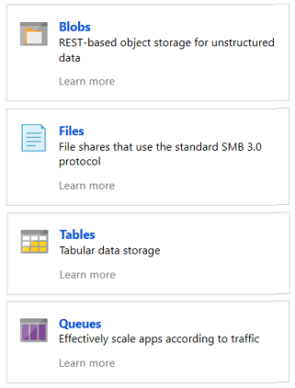
Azure Storage Services
Azure Blobs: A massively scalable object store for text and binary data
Azure Files: Managed file shares for cloud or on-premises deployments
Azure Tables: A NoSQL store for schema less storage of structured data
Azure Queues: A messaging store for reliable messaging between application components
Notes:
Blobs and Files each have a lesson. This is the only time Tables and Queues are discussed.

Slide 38
Storage Account Types
Storage account type | Supported services | Supported tiers | Replication options
Blob storage | Blob (block blobs and append blobs only) | Standard | LRS, GRS, RA-GRS
General-purpose V2 | Blob, File, Queue, Table, and Disk | Standard, Premium | LRS, GRS, RA-GRS, ZRS, ZGRS (preview), RA-ZGRS (preview)
General-purpose V1 | Blob, File, Queue, Table, and Disk | Standard, Premium | LRS, GRS, RA-GRS
Block blob storage | Blob (block blobs and append blobs only) | Premium | LRS
File Storage | Files only | Premium | LRS
✔️ All storage accounts are encrypted using Storage Service Encryption (SSE) for data at rest

Slide 39
Accessing Storage
CNAME record | Target
blobs.contoso.com | contosoblobs.blob.core.windows.net
Every object has a unique URL address
The storage account name forms the subdomain of that address
The subdomain and domain name forms an endpoint
Blob service: http://mystorageaccount.blob.core.windows.net
Table service: http://mystorageaccount.table.core.windows.net
Queue service: http://mystorageaccount.queue.core.windows.net
File service: http://mystorageaccount.file.core.windows.net
If you prefer you can configure a custom domain name
Notes:
Endpoints are covered in more detail in the Virtual Networking lesson.
✔️A Blob storage account only exposes the Blob service endpoint. And, you can also configure a custom domain name to use with your storage account.

Slide 40
Demonstration – Creating a Storage Account
Create a storage account in the portal
Create a storage account using PowerShell
Create a storage account using CLI
Notes:
✔ Always consider having students walk-through the demonstrations themselves. Also, consider the overlap with the formal labs and your best use of time.

Slide 41
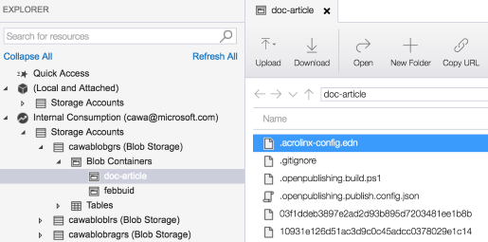
Azure Storage Explorer
Access multiple accounts and subscriptions
Create, delete, view, edit storage resources
View and edit Blob, Queue, Table, File, Cosmos DB storage and Data Lake Storage
Obtain shared access signature (SAS) keys
Available for Windows, Mac, and Linux

Slide 42
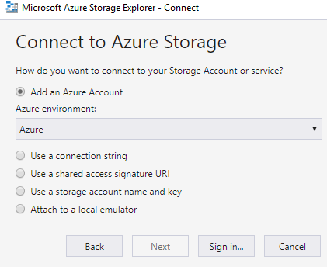
Storage Explorer Connection Options
Connect to an Azure subscription
Work with local development storage (emulator)
Attach to external storage
Attach a storage account or storage service by using a shared access signature
Connect to an Azure Cosmos DB account by using a connection string

Slide 43
Demonstration – Storage Explorer
Download and install Storage Explorer
Connect to an Azure subscription
Attach an Azure storage account
Notes:
✔ Always consider having students walk-through the demonstrations themselves. Also, consider the overlap with the formal labs and your best use of time.

Slide 44
Lesson 02: Blob Storage

Slide 45
Blob Storage Overview
Blob Storage
Blob Containers
Blob Performance Tiers
Uploading Blobs
Blob Access Policies
Blob Storage Pricing
Demonstration – Blob Storage
Notes:
Lesson overview

Slide 46
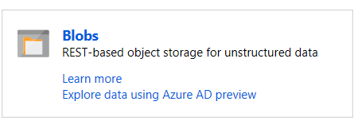
Blob Storage
Stores unstructured data in the cloud
Can store any type of text or binary data
Also referred to as object storage
Common uses:
Serving images or documents directly to a browser
Storing files for distributed access
Streaming video and audio
Storing data for backup and restore, disaster recovery, archiving
Storing data for analysis by an on-premises or Azure-hosted service
Notes:
For more information, you can see:
Azure Blob Storage - https://azure.microsoft.com/en-us/services/storage/blobs/

Slide 47
Azure Blob storage resource hierarchy
Storage account
Container
Blob
Header.jpg
Images
Advertisement.png
Media
Videos
Intro.mp4
Notes:
Azure Blob storage allows access to stored data through its resources. Azure Blob storage contains the following components:
Storage account: This refers to an account that you can use to access Azure Storage. In terms of hierarchy, it’s the parent account of the container and blob resources.
Container: This refers to a collection of objects that are grouped together and accessed by using the same base Uniform Resource Identifier (URI).
Blob: This refers to an object, typically a media file or a disk, that is stored in the container.

Slide 48
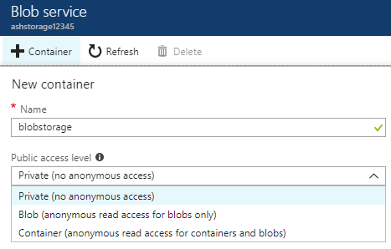
Blob Containers
All blobs must be in a container
Accounts have unlimited containers
Containers can have unlimited blobs
Private blobs - no anonymous access
Blob access - anonymous public read access for blobs only
Container access - anonymous public read and list access to the entire container, including the blobs
Notes:
✔️ You can also create the Blob container with PowerShell using the New-AzureStorageContainer command.
✔️ Have you thought about how you will organize your containers?

Slide 49
Storage tiers
Storage tiers allow you to tune performance and cost to a ratio that is ideal for your solution
There are three tiers:
Hot
The most common tier
Used for data that is accessed frequently
Cool
Used for data that is infrequently accessed
Archive
Used for data that must be retained but is rarely accessed
Data stored at this tier must be flexible for hours-based latency
Ideal for data that is stored at least 180 days
Ideal for data that is stored at least 30 days
✔️ You can switch between these access tiers at any time.
Notes:
Azure Storage offers different storage tiers, which allow you to store Blob object data in the most cost-effective manner. The available tiers include:
Hot storage: is optimized for storing data that is accessed frequently.
Cool storage is optimized for storing data that is infrequently accessed and stored for at least 30 days.
Archive storage is optimized for storing data that is rarely accessed and stored for at least 180 days with flexible latency requirements (on the order of hours).
The following considerations accompany the different storage tiers:
The Archive storage tier is only available at the blob level and not at the storage account level.
Data in the Cool storage tier can tolerate slightly lower availability, but still requires high durability and similar time-to-access and throughput characteristics as Hot data. For Cool data, a slightly lower availability SLA and higher access costs compared to Hot data are acceptable tradeoffs for lower storage costs.
Archive storage is offline and offers the lowest storage costs but also the highest access costs.
Only the Hot and Cool storage tiers can be set at the account level. Currently the Archive tier cannot be set at the account level.
Hot, Cool, and Archive tiers can be set at the object level.

Slide 50
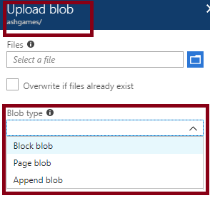
Uploading Blobs
Block blobs (default) - useful for storing text or binary files
Page blobs - More efficient for frequent read/write operations
Append blobs - useful for logging scenarios
You cannot change a blob type once it has been created
Notes:
✔️ Once the blob has been created, its type cannot be changed.

Slide 51
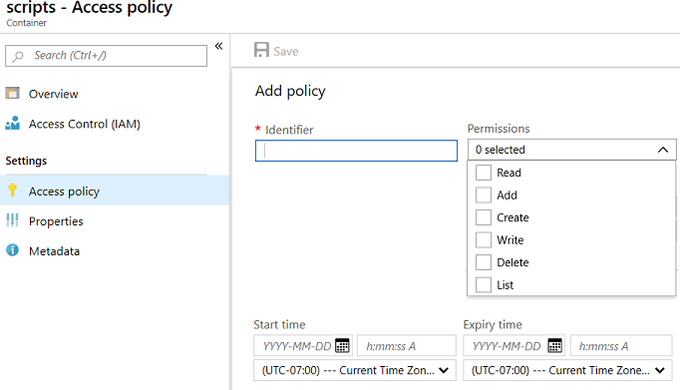
Blob Access Policies
Provides an additional level of control over server-side SAS
Groups SAS to provide additional restrictions for signatures bound to the policy
Supported for Blob containers, File shares, Tables, and Queues
Notes:
SAS is covered in more detail in the last lesson.

Slide 52
Storage Pricing
Storage costs
Blob storage
Data access costs
Transaction costs
Geo-Replication data transfer costs
Outbound data transfer costs
Changing the storage tier

Slide 53
Demonstration – Blob Storage
Create a container
Upload a block blob
Download a block blob
Explore with Storage Explorer (optional)
Notes:
✔ Always consider having students walk-through the demonstrations themselves. Also, consider the overlap with the formal labs and your best use of time.

Slide 54
Lesson 03: Azure Files

Slide 55
Azure Files Overview
Azure Files
Files vs Blobs
Creating File Shares
Mapping File Shares (Windows)
Mapping File Shares (Linux)
Secure Transfer Required
File Share Snapshots
Demonstration – File Shares
Notes:
Lesson overview

Slide 56
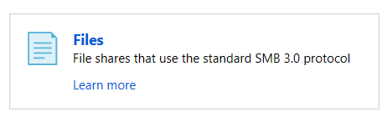
Azure Files
Managed file shares in the cloud that are accessible via SMB
Common uses:
Replace and supplement
Lift and shift
Azure File Sync
Shared applications
Diagnostic data
Tools and utilities
Notes:
✔️ Which of the usage cases for file shares are you most interested in?
For more information, you can see:
What is Azure Files?- [https://docs.microsoft.com/en-us/azure/storage/files/storage-files-introduction](https://docs.microsoft.com/en-us/azure/storage/files/storage-files-introduction)

Slide 57
Files vs Blobs
Feature | Description | When to use
Azure Files | SMB interface, client libraries, and a REST interface that allows access from anywhere to stored files. | Lift and shift an application to the cloud. Store shared data across multiple virtual machines. Store development and debugging tools that need to be accessed from many virtual machines.
Azure Blobs | Client libraries and a REST interface that allows unstructured data (flat namespace) to be stored and accessed at a massive scale in block blobs. | Support streaming and random-access scenarios. Access application data from anywhere.
Notes:
✔️ When selecting which storage feature to use, you should also consider pricing.

Slide 58
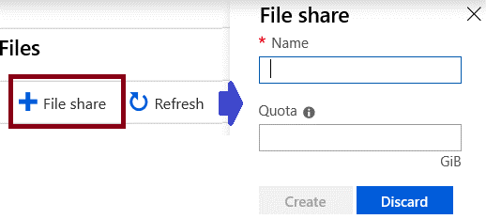
Creating File Shares
Portal
PowerShell
# Retrieve storage account and storage account key
$storageContext = New-AzStorageContext <storage-account-name> <storage-account-key>
# Create the file share, in this case “logs”
$share = New-AzStorageShare logs -Context $storageContext

Slide 59
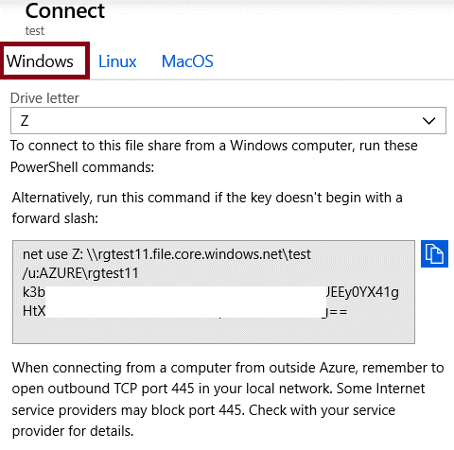
Mapping File Shares (Windows)
Mapping drive letter
UNC path
Account user
Storage Account Key
✔️ Ensure port 445 is open
Notes:
Storage account has been redacted.

Slide 60
Mounting File Shares (Linux)
sudo mount -t cifs //<storage-account-name>.file.core.windows.net/<share-name> <mount-point> -o vers=<smb-version>,username=<storage-account-name>,password=<storage-account-key>,dir_mode=0777,file_mode=0777,serverino
Install the cifs-utils package
Meet the SMB client requirements
Decide on the directory file chmod permissions
Create an entry in /etc/fstab to persist the mount
Notes:
For more information, you can see:
Use Azure Files with Linux - https://docs.microsoft.com/en-us/azure/storage/files/storage-how-to-use-files-linux
Create a persistent mount point for the Azure file share with /etc/fstab - https://docs.microsoft.com/en-us/azure/storage/files/storage-how-to-use-files-linux#create-a-persistent-mount-point-for-the-azure-file-share-with-etcfstab

Slide 61
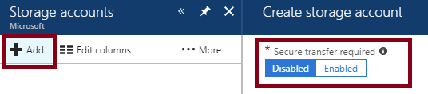
Secure Transfer Required
Only allows requests by secure connection such as HTTPs
Portal
PowerShell
Set-AzStorageAccount
-Name "{StorageAccountName}"
-ResourceGroupName "{ResourceGroupName}"
-EnableHttpsTrafficOnly $True
Notes:
✔️ Because Azure storage doesn’t support HTTPs for custom domain names, this option is not applied using a custom domain name.
For more information, you can see:
Require secure transfer in Azure Storage - https://docs.microsoft.com/en-us/azure/storage/common/storage-require-secure-transfer

Slide 62
File Share Snapshots
Captures the share state at that point in time
Is read-only copy of your data
Snapshot at the file share level
Retrieve at the individual file level
Incremental in nature
Uses:
Protection against application error and data corruption.
Protection against accidental deletions or unintended changes.
General backup purposes.

Slide 63
Demonstration – File Shares
Create a file share and upload a file
Manage snapshots
Create a file share (PowerShell)
Mount a file share (PowerShell)
Notes:
✔ Always consider having students walk-through the demonstrations themselves. Also, consider the overlap with the formal labs and your best use of time.

Slide 64
Lesson 04: Storage Security

Slide 65
Storage Security Overview
Storage Security
Shared Access Signatures
Configuring SAS Parameters
URI and SAS Parameters
Demonstration – SAS (Portal)
Storage Service Encryption
Customer Managed Keys
SAS Best Practices
Demonstration – SAS (Storage Explorer)
Notes:
Lesson overview

Slide 66

Shared Access Signatures (SAS)
Provides delegated access to resources
Grants access to clients without sharing your storage account keys
The account SAS delegates access to resources in one or more of the storage services: Blob, Queue, Table, or File service
The service SAS delegates access to a resource in just one of the storage services
Notes:
For more information, you can see:
What is a shared access signature? - https://docs.microsoft.com/en-us/azure/storage/common/storage-dotnet-shared-access-signature-part-1?toc=%2fazure%2fstorage%2fblobs%2ftoc.json#what-is-a-shared-access-signature

Slide 67
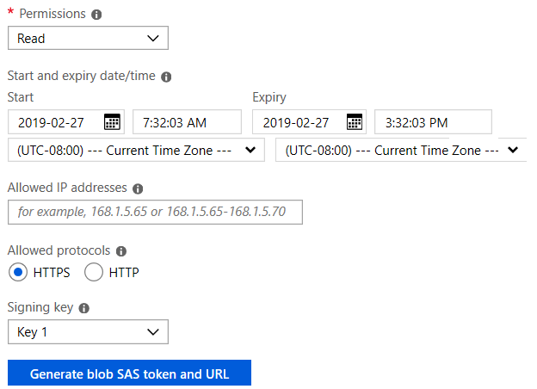
Configuring SAS Parameters
Account level SAS, full permissions
New-AzStorageAccountSASToken
-Service Blob,File,Table,Queue
-ResourceType Service,Container,Object
-Permission "racwdlup"
Blob level SAS, full permissions
New-AzStorageBlobSASToken
-Container "ContainerName"
-Blob "BlobName"
-Permission rwd

Slide 68
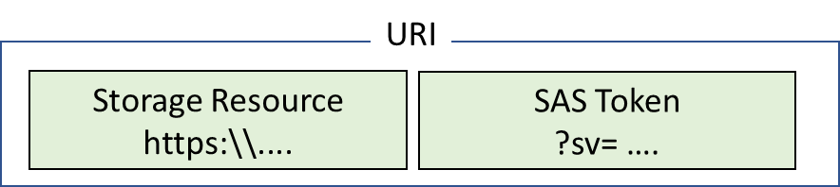
URI and SAS Parameters
A SAS is a signed URI that points to one or more storage resources
Consists of a storage resource URI and the SAS token
https://myaccount.blob.core.windows.net/?restype=service&comp=properties&sv=2015-04-05&ss=bf&srt=s&st=2015-04-29T22%3A18%3A26Z&se=2015-04-30T02%3A23%3A26Z&sr=b&sp=rw&sip=168.1.5.60-168.1.5.70&spr=https &sig=F%6GRVAZ5Cdj2Pw4txxxxx
Includes parameters for resource URI, storage services version, services, resource types, start time, expiry time, resource, permissions, IP range, protocol, signature
Notes:
For more information, you can see:
Shared access signature parameters - https://docs.microsoft.com/en-us/azure/storage/common/storage-dotnet-shared-access-signature-part-1?toc=%2fazure%2fstorage%2fblobs%2ftoc.json#shared-access-signature-parameters

Slide 69
Demonstration – SAS (Portal)
Create a SAS at the service level
Create a SAS at the account level
Notes:
✔ Always consider having students walk-through the demonstrations themselves. Also, consider the overlap with the formal labs and your best use of time.

Slide 70
Storage Service Encryption
Protects your data for security and compliance
Automatically encrypts and decrypts your data
Encrypted through 256-bit AES encryption
Is enabled for all new and existing storage accounts and cannot be disabled
Is transparent to users
✔️ You can use your own key (next topic)
Notes:
✔️ SSE is enabled for all new and existing storage accounts and cannot be disabled. Because your data is secured by default, you don't need to modify your code or applications.

Slide 71
Customer Managed Keys
Use the Azure Key Vault to manage your encryption keys
Create your own encryption keys and store them in a key vault
Use Azure Key Vault's APIs to generate encryption keys
Custom keys give you more flexibility and control
Notes:
✔️ To use customer-managed keys with SSE, you can either create a new key vault and key or you can use an existing key vault and key. The storage account and the key vault must be in the same region, but they can be in different subscriptions.
✔️ The key vault can also be used to store BitLocker keys.

Slide 72
Best Practices
Always use HTTPS to create or distribute an SAS
Reference stored access policies where possible
Use near-term expiration times on an ad hoc SAS
Have clients automatically renew the SAS if necessary
Be careful with SAS start time
Be specific with the resource to be accessed
Understand that your account will be billed for any usage
Validate data written using SAS
Don't assume SAS is always the correct choice
Use Storage Analytics to monitor your application

Slide 73
Demonstration – SAS (Storage Explorer)
Generate a SAS connection string for the account you want to share
Attach to a storage account by using a SAS Connection string
Notes:
✔ Always consider having students walk-through the demonstrations themselves. Also, consider the overlap with the formal labs and your best use of time.

Slide 74
Lesson 05: Lab and Review Questions

Slide 75
Lab: Implement and Manage Storage
Adatum Corporation wants to leverage Azure Storage for hosting its data
Exercise 0. Prepare the lab environment
Exercise 1. Implement and use Azure Blob Storage
Exercise 2. Implement and use Azure File Storage
Lab time: 60 minutes
Notes:
There are two topics in the Data Service module, Import and Export Service lesson, that discuss AzCopy. That tool is used in the lab, if you want to review the syntax.

Slide 76
Module Review Questions
Notes:
As you have time go through the Module Review questions in the student materials.

Slide 77
Lesson 02: File Sync

Slide 78
File Sync Overview
Azure File Sync
File Sync Components
File Sync – Initial Steps
File Sync - Synchronization
Notes:
Lesson overview

Slide 79
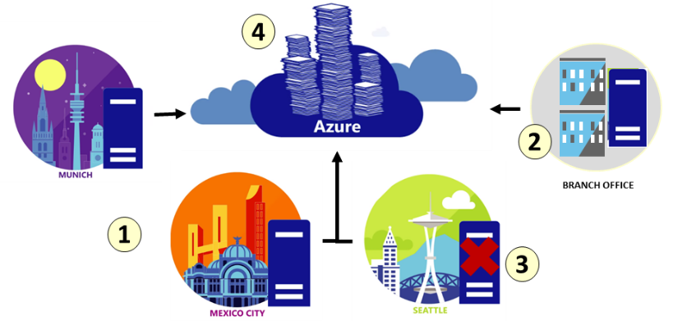
Azure File Sync
Centralize file shares in Azure Files
Lift and shift
Branch Office backups
Backup and Disaster Recovery
File Archiving
Notes:
✔ At the time of this writing Azure File Sync is in preview. Be sure to consult the documentation for any new updates.
✔️ Cloud tiering is an optional feature of Azure File Sync in which frequently accessed files are cached locally on the server while all other files are tiered to Azure Files based on policy settings.
For more information, you can see:
Planning for an Azure File Sync deployment - https://docs.microsoft.com/en-us/azure/storage/files/storage-sync-files-planning

Slide 80
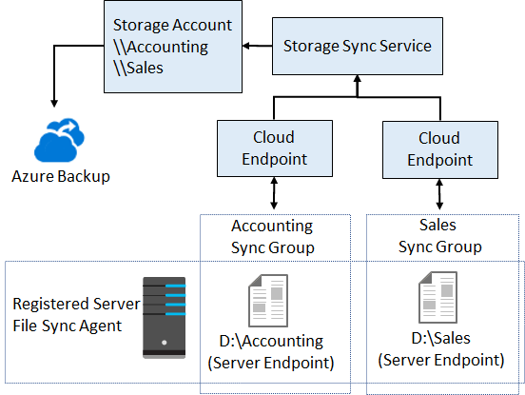
File Sync Components
The Storage Sync Service is the top-level resource.
The registered server object represents a trust relationship between your server (or cluster) and the Storage Sync Service
The Azure File Sync agent is a downloadable package that enables Windows Server to be synced with an Azure file share
A server endpoint represents a specific location on a registered server, such as a folder
A cloud endpoint is an Azure file share
A sync group defines which files are kept in sync

Slide 81
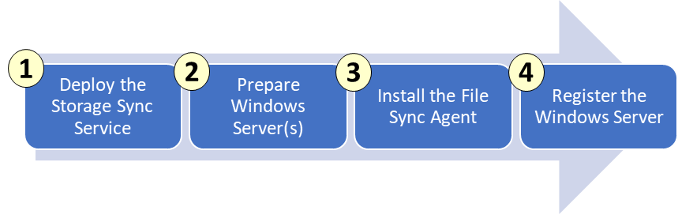
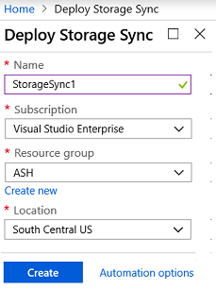
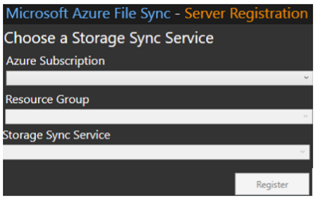
File Sync - Initial Steps
Notes:
✔ Continue to the next topic for an explanation of how files are synchronized.

Slide 82
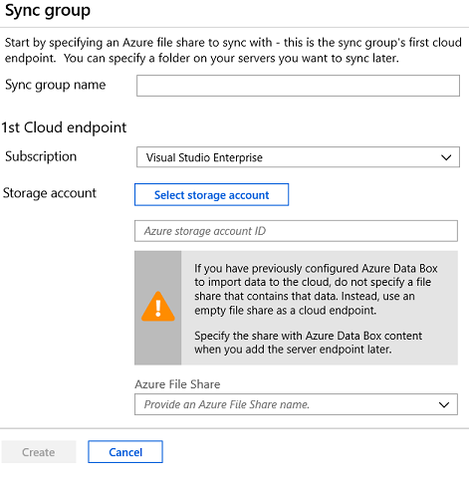
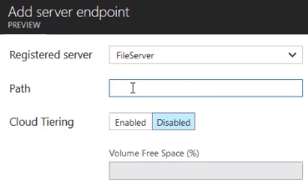
File Sync - Synchronization
Create a sync group with at least one cloud endpoint. The endpoint will have a storage account and file share
Create a server endpoint with the registered server, path, and optional cloud tiering information
Notes:
The module lab is on File Sync.
✔ Regardless of whether cloud tiering is enabled, your Azure file share always has a complete copy of the data in the sync group.
✔ Azure File Sync moves file data and metadata exclusively over HTTPS and requires port 443 to be open outbound. Based on policies in your datacenter, branch or region, further restricting traffic over port 443 to specific domains may be desired or required.

Slide 83
Lesson 03: Import and Export Service

Slide 84
Import and Export Service Overview
Import and Export Service
Components and Requirements
Import and Export Tool
Import Jobs
Export Jobs
AzCopy
Demonstration - AzCopy
Notes:
Lesson overview

Slide 85
Import and Export Service
Import/transfer large amounts of data to Azure Blob storage and Azure Files
Export/transfer data from Azure storage to hard disk drives
Migrating data to the cloud
Content distribution
Backup
Data recovery
Notes:
✔️ A single job can include up to 10 disks. You can create jobs directly from the Azure portal. You can also accomplish this programmatically by using Azure Storage Import/Export REST API.

Slide 86
Components and Requirements
Components
Import/Export service helps the user create and track jobs
WAImportExport tool command line tool for drive preparation and repair
Disk Drives can be SSDs (2.5”) or HDDs (2.5” and 3.5”)
Requirements
Windows Server (64-bit and BitLocker) or Client (WMF and BitLocker)
General Purpose v2 storage accounts is recommended
Import jobs can include Azure Blob storage, Azure File storage, Block blobs, and Page blobs.
Export jobs can include Azure Blob storage, Block blobs, Page blobs, and Append blobs. Azure Files not supported.

Slide 87
Import and Export Tool
WAImportExport.exe PrepImport /j:<JournalFile> /id:<SessionId> /DataSet:<dataset.csv>
Copy data to the hard drives for shipment to an Azure datacenter
Repair any blobs that were not useable (import or export)
Internal SATA II/III HDDs or SSDs
Handles data copy, volume encryption, and creation of journal files
Journal files track a set of drives and records the progress
Session Id identifies a copy session
A CSV file contains a list of directories/files for copying

Slide 88
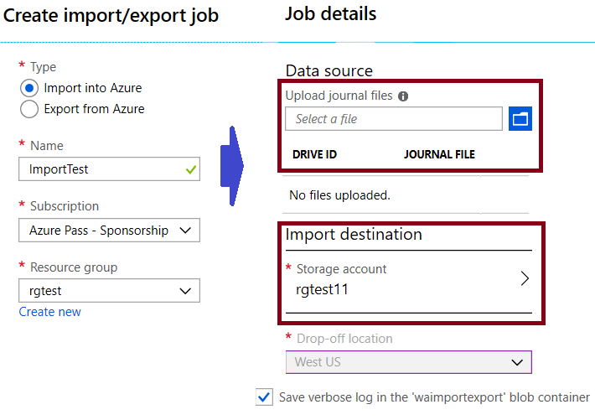
Import Jobs
Create an Azure Storage account
Identify the number of disks
Install the WAImportExport tool
Use the tool to copy the data, encrypt the drive with BitLocker, and generate journal files
Create the import job in the portal
Ship the disks to the import destination
Datacenter imports and returns the disks
Notes:
For more information, you can see:
Inside an import job - https://docs.microsoft.com/en-us/azure/storage/common/storage-import-export-service#inside-an-import-job

Slide 89
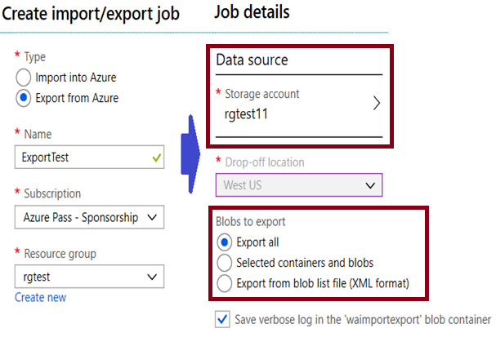
Export Jobs
Identify the data to export
Identify the number of disks
Create the export job in the portal, including your return address
Ship the required number of disks
Datacenter staff will export and encrypt the data.
Copied disks are shipped to you.
BitLocker keys will be in the portal.
Notes:
For more information, you can see:
Inside an export job - https://docs.microsoft.com/en-us/azure/storage/common/storage-import-export-service#inside-an-export-job

Slide 90
AzCopy
AzCopy /Source:<source> /Dest:<destination> [Options]
Command-line utility
Available on Windows, Linux, and MacOS
Designed for copying data to and from Azure Blob, File, and Table storage
Authentication options include Active Directory or SAS token
Example 1: Copy a Blob storage account to another account
Example 2: List/Remove files and blobs in a given path (wildcard support)
Notes:
For more information, you can see:
Download and install AzCopy on Windows - https://docs.microsoft.com/en-us/azure/storage/common/storage-use-azcopy#download-and-install-azcopy-on-windows

Slide 91
Demonstration - AzCopy
Install the AzCopy tool
Explore the help
Download a blob from Blob storage to the file system
Upload files to Azure blob storage
Notes:
✔ Always consider having students walk-through the demonstrations themselves. Also, consider the overlap with the formal labs and your best use of time.

Slide 92
Lesson 04: Data Box

Slide 93
Data Box Overview
Data Box
Offline – Use Cases
Offline – Data Box Products
Offline – Product Selection
Offline – Implementation Offline Products
Online – Data Product Gateway
Online – Data Box Edge
Online – Implementation Online Products
Notes:
Lesson overview

Slide 94
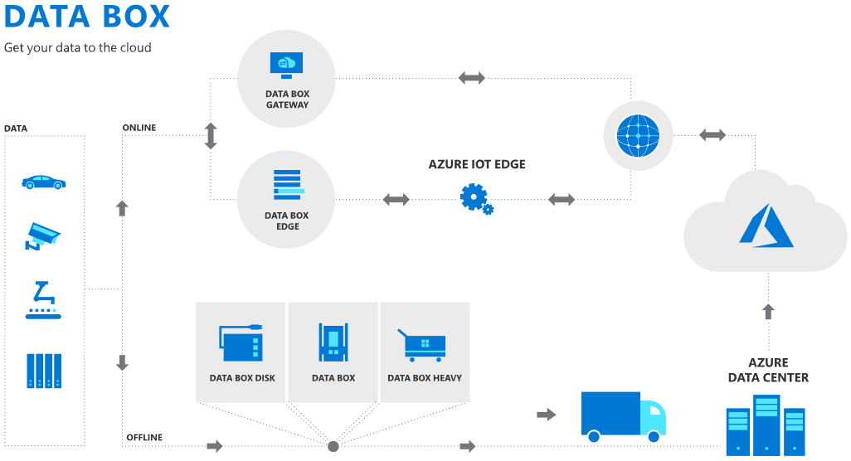
Data Box
Data Box Offline
Data Box
Data Box Disk
Data Box Heavy
Data Box Online
Data Box Edge
Data Box Gateway
Notes:
For more information, you can see:
Azure Data Box Products - https://azure.microsoft.com/en-us/services/storage/databox/
Azure Data Box - https://docs.microsoft.com/en-us/azure/databox-family/

Slide 95
Offline: Use Cases
One-time migration
Moving data from offline tapes to archival data in Azure cool storage
Moving a media library from offline tapes into Azure to create an online media library
Migrating your VM farm, SQL server, and applications to Azure
Moving historical data to Azure for in-depth analysis and reporting using HDInsight
Moving backup data to Azure for offsite storage
Incremental transfer
Periodic uploads

Slide 96
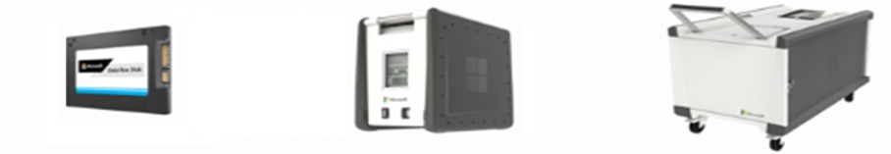
Offline: Data Box Products
Data Box Disk
Best for projects that require a smaller form factor
Capacity: 8 TB ea.
Secure, ruggedized USB drives orderable in packs of 5 (up to 40 TB)
Data Box
Bulk migration to Azure when a network isn’t an option
Capacity: 100 TB
Weight: ~ 50 lbs.
Secure, ruggedized appliance
Data Box Heavy
Same service as Data Box, but targeted to petabyte-sized datasets
Capacity: 1 PB
Weight: 500+ lbs.
Secure, ruggedized appliance

Slide 97
Offline: Product Selection
Speed and time
Security
Product | Network Interfaces
Data Box Disk | USB 3.0 connection
Data Box | 1 Gbps or 10 Gbps network interfaces
Data Box Heavy | High performance 40 Gbps network interfaces
Product | Physical security | Encryption
Data Box Disk | The disks are tamper-resistant and support secure update capability. | The data is secured with AES 128-bit encryption.
Data Box | Rugged device casing secured by tamper-resistant screws and tamper-evident stickers | The data is secured with AES 256-bit encryption.
Data Box Heavy | Rugged device casing secured by tamper-resistant screws and tamper-evident stickers | The data is secured with AES 256-bit encryption.
Notes:
✔️ Once your data is uploaded to Azure, the disks on the device are wiped clean, in accordance with NIST 800-88r1 standards.

Slide 98
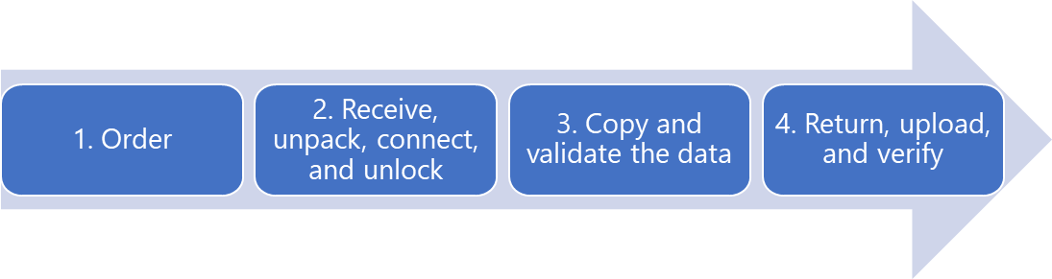
Offline: Implementation Workflow
Create an order in the portal and the products are shipped to you.
Receive, unpack, connect, and unlock – configure the network and mount share on the host computer.
Copy and validate the data.
Return, upload, verify.
✔️ Device disks are securely erased as per the NIST guidelines.

Slide 99

Online: Data Box Gateway
Use cases:
Cloud archival
Data aggregation
Integration with on-premises workloads
Benefits:
Easy data transfer
High speed performance
Fast access
Limited bandwidth usage
Data Box Gateway
Virtual network transfer appliance, runs on your choice of hardware
Device provisioned in our hypervisor
Supports storage gateway, SMB, NFS, Azure blob, and files

Slide 100

Online: Data Box Edge
Use cases:
Pre-process data
Inference Azure Machine Learning
Transfer data over the network
Benefits:
Easy data transfer
High speed performance
Fast access
Limited bandwidth usage
Transform data
Data Box Edge
Manages uploads to Azure and can pre-process data prior to upload
Local cache capacity: ~12 TB
Includes Data Box Gateway and Azure IoT Edge

Slide 101
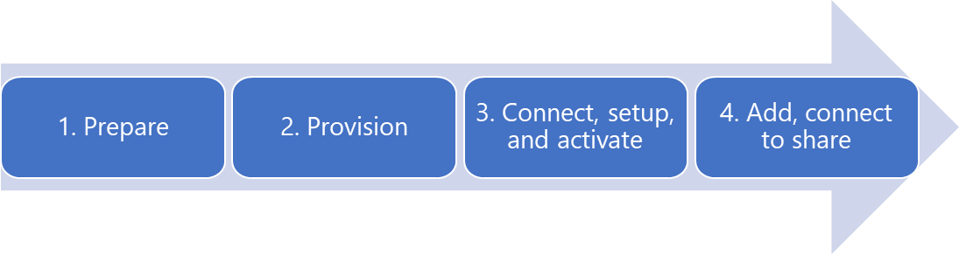
Online: Implementation Workflow
Prepare. Checking prerequisites, creating a new Data Box Gateway in the portal, downloading the virtual device image for Hyper-V or VMware, and obtaining the activation key.
Provision. Verify requirements, provision the device, start the device, and get the IP address.
Connect, setup, and activate. Connect to the local web UI setup page. Provide the device name and activation key.
Add, connect to the share. Once your SMB or NFS share is created you can connect and begin transferring data.
Notes:
For more information, you can see:
Tutorial: Prepare to deploy Azure Data Box Edge - https://docs.microsoft.com/en-us/azure/databox-online/data-box-edge-deploy-prep

Slide 102
Lesson 05: Lab and Review Questions

Slide 103
Lab: Implementing File Sync
Adatum Corporation is implementing Azure File Sync as an efficient method to replicate its on-premises data to Azure file shares.
Exercise 0. Prepare the lab environment
Exercise 1. Prepare Azure File Sync infrastructure
Exercise 2. Implement Azure File Sync
Lab time: 60 minutes

Slide 104
Module Review Questions
Notes:
As you have time go through the Module Review questions in the student materials.

Slide 105
AZ-103T00A Module 11: Governance and Compliance

Slide 106
Module Overview
Subscriptions and Accounts
Role-based Access Control (RBAC)
Users and Groups
Azure Policy
Lab and Review Questions

Slide 107
Lesson 01: Subscriptions and Accounts

Slide 108
Subscriptions and Accounts Overview
Management Group
Creating Management Groups
Azure Subscriptions
Getting a Subscription
Subscription Usage
Subscription User Types
Check Resource Limits
Resource Tags
Billing
Notes:
Lesson overview

Slide 109
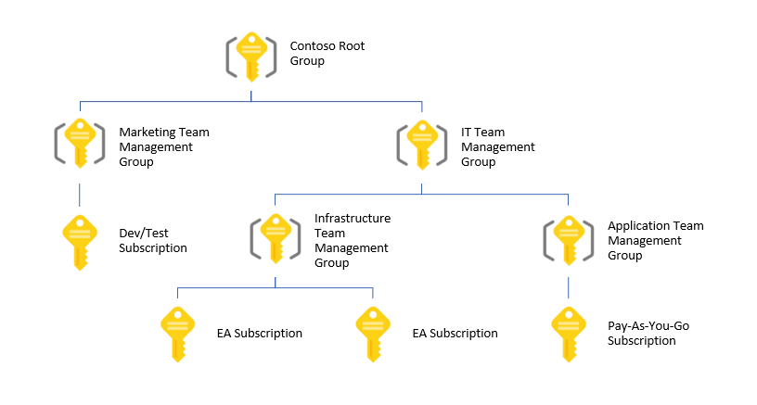
Management Groups
Provides a level of scope above subscriptions
Organizational alignment for your Azure subscriptions through custom hierarchies and grouping
Targeting of policies and spend budgets across subscriptions and inheritance down the hierarchies
Compliance and cost reporting by organization (business/teams)

Slide 110
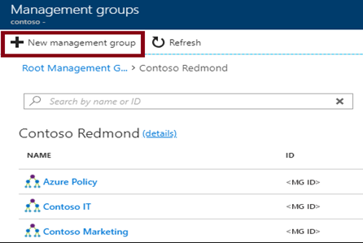
Creating Management Groups
The Management Group ID is the directory unique identifier that is used to submit commands on this management group
The Display Name field is the name that is displayed within the Azure portal

Slide 111
Azure Subscriptions
A subscription is a logical unit of Azure services that is linked to an Azure account
Subscriptions help you organize access to cloud service resources
Subscriptions have accounts
An Azure account is simply an identity in Azure Active Directory (Azure AD) or in a directory that is trusted by Azure AD, such as a work or school organization
Users,
groups, and service principles
Azure Active Directory
Authentication
& Authorization
Azure resources in resource groups
Azure Subscription(s)
Notes:
✔️ Do you know how many subscriptions your organization has? Do you know how resources are organized into resource groups?

Slide 112
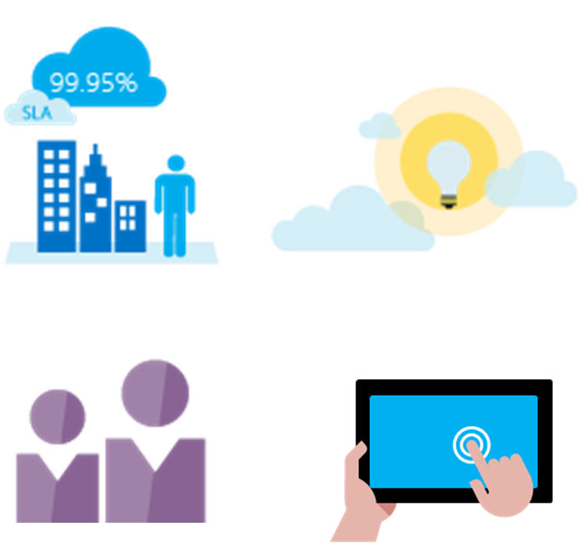
Getting a Subscription
Enterprise Agreement customers make an upfront monetary commitment and consume services throughout the year
Resellers provide a simple, flexible way to purchase cloud services
Partners can design and implement your Azure cloud solution
Personal free account -start right away
Notes:
✔️ Which subscription model are you most interested in?
For more information, you can see:
Solution providers - https://www.microsoft.com/en-us/solution-providers/home

Slide 113
Subscription Usage
Subscription | Usage
Free | Includes a $200 credit for the first 30 days, free limited access for 12 months
Pay-As-You-Go | Charges you monthly
Enterprise | One agreement, with discounts for new licenses and Software Assurance - targeted at enterprise-scale organizations.
Student | Includes $100 for 12 months – must verify student access
Notes:
Note: Credit card information is used for identity verification only. You won’t be charged for any services until you upgrade.

Slide 114
Subscription User Types
Administrative Role | Limit | Summary
Account Administrator | 1 per Azure account | Authorized to access the Account Center
Service Administrator | 1 per Azure subscription | Authorized to access the Azure Management Portal for all subscriptions in the account
Co-administrator | 200 per subscription | Same as the Service Administrator but can’t change the association of subscriptions to Azure directories
Notes:
✔️ Account Administrators using a Microsoft account must log in every 2 years (or more frequently) to keep the account active. Inactive accounts are cancelled, and the related subscriptions removed. There are no login requirements if using a work or school account.

Slide 115
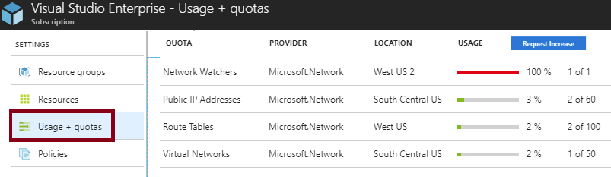
Check Resource Limits
All resources have a maximum limit listed in Azure limits
Helpful to track current usage, and plan for future use
You can request an increase

Slide 116
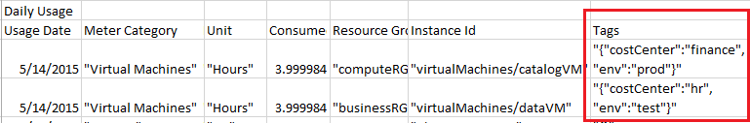
Resource Tags
Tags logically organize your resources
Tags consist of a name and value
Useful especially in billing
Notes:
✔️ If you must create a lot of tags you will want to do that programmatically. You can use PowerShell or the CLI.

Slide 117
Billing
Pricing Calculator – estimate expenditures in all areas of Azure
Billing Alert Service - monitor and manage billing activity
Create and Manage a Budget - plan for and drive organizational accountability
Azure Reservations - helps you save money by pre-paying for services

Slide 118
Lesson 02: Role-based Access Control

Slide 119
Role-based Access Control Overview
RBAC Concepts
RBAC Roles
Administrator Permissions
Role Assignment
Role Definitions
Demonstration - RBAC
Notes:
Lesson overview

Slide 120
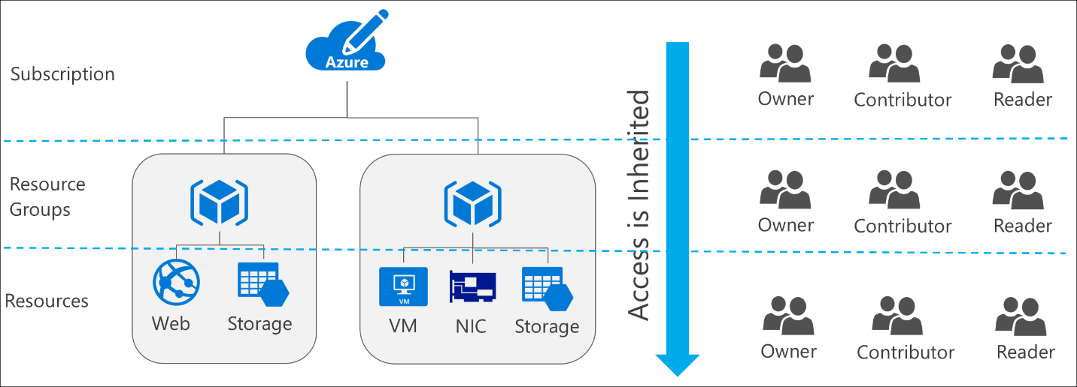
RBAC Concepts
Define what actions are allowed and/or denied
Associate the role with a user, group or service principal
Scope to a subscription, a resource group, or specific resources
Notes:
✔️ Users and groups are sourced from Azure Active Directory, which is commonly populated with credentials from on-premises directories, such as Active Directory. Note that RBAC access that you grant at parent scopes is inherited at child scopes.

Slide 121
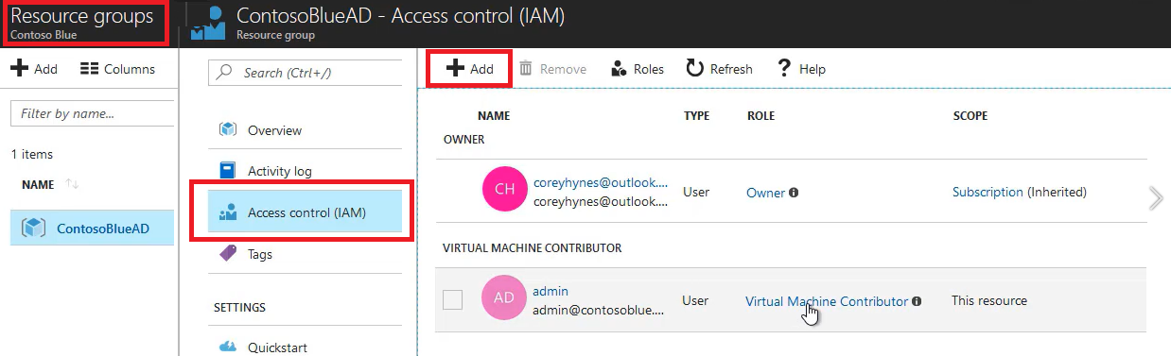
RBAC Roles
Owner can manage everything, including access
Contributors can manage everything except access
Readers can view everything but can't make changes

Slide 122
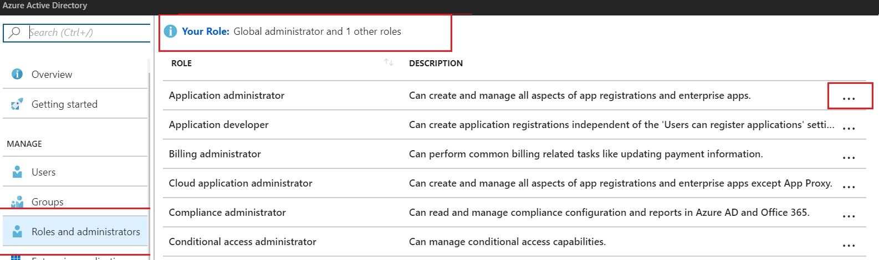
Administrator Permissions
Designate separate administrators for different functions
Global administrators can access all administrative features
Global administrators can assign other administrators

Slide 123
Role Assignment
Users
Assigned to organizational users in the AD associated with the subscription
Or, external Microsoft accounts in the same directory
Groups
Assigned to Azure AD security groups
Best practice: manage access through groups, adding roles, and assigning users
Service Principals
Service identities represented as service principals in the directory
Authenticate with Azure AD and securely communicate with one another

Slide 124
Role Definitions
Built-in Role | Action | NotActions
Owner (allow all actions) | *
Contributor (allow all actions except writing or deleting role assignment) | * | Microsoft.Authorization/*/Delete, Microsoft.Authorization/*/Write, Microsoft.Authorization/elevateAccess/Action
Reader (allow all read actions) | */read
Name : Owner
ID : 8e3af657-a8ff-443c-a75c-2fe8c4bcb65
IsCustom : False
Description : Manage everything, including access to resources
Actions : {*}
NotActions : {}
AssignableScopes : {/}
Notes:
For more information, you can see:
Built-in roles in Azure - https://docs.microsoft.com/en-us/azure/role-based-access-control/built-in-roles
Create custom roles for Azure Role-Based Access Control - https://docs.microsoft.com/en-us/azure/active-directory/role-based-access-control-custom-roles

Slide 125
Demonstration - RBAC
Locate the Access Control blade
Review role permissions
Add a role assignment
Explore PowerShell commands
Notes:
✔ Always consider having students walk-through the demonstrations themselves. Also, consider the overlap with the formal labs and your best use of time.

Slide 126
Lesson 03: Users and Groups

Slide 127
Users and Groups Overview
User Accounts
Adding User Accounts
Bulk User Accounts
Group Accounts
Adding Group Members
Adding a Group Owner
Demonstration – Users and Groups
Notes:
Lesson overview

Slide 128
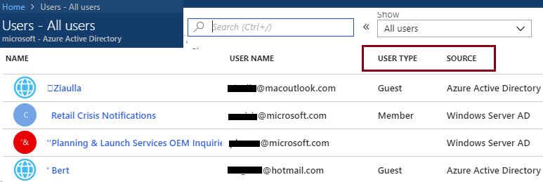
User Accounts
All users must have a user account
The account is used for authentication and authorization
Identity Sources: Cloud, Directory-synchronized, and Guest
Notes:
✔️ Have you given any thought as to the type of users you will need?

Slide 129
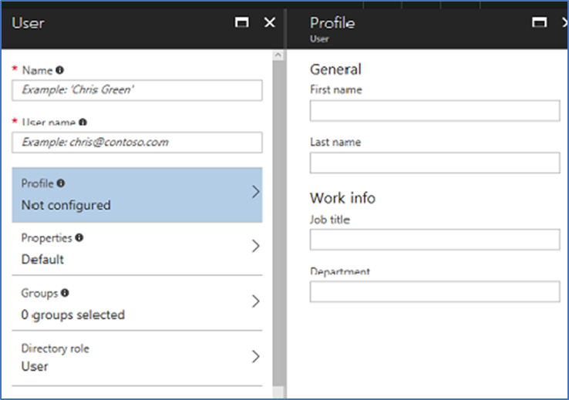
Adding User Accounts
# Create a password object
$PasswordProfile = New-Object -TypeName Microsoft.Open.AzureAD.Model.PasswordProfile
# Assign the password
$PasswordProfile.Password = "<Password>“
# Create the new user
New-AzureADUser -AccountEnabled $True -DisplayName "Abby Brown" -PasswordProfile $PasswordProfile -MailNickName "AbbyB" -UserPrincipalName AbbyB@contoso.com
Notes:
✔️ Users can also be added to Azure AD through Office 365 Admin Center, Microsoft Intune admin console, and the CLI. Which of the options mentioned in this topic do you prefer?

Slide 130
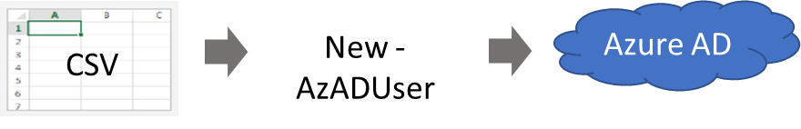
Bulk User Accounts
Use Connect-AzureAD to create a PowerShell connection to your directory
Create a new Password Profile for the new users
Use Import-CSV to import the csv file
Loop through the users in the file constructing the user parameters
Use New-AzADUser to create each user
Be sure to enable each account
Notes:
✔️ Establish or implement a naming convention for usernames, display names and aliases. The password for the new users needs to conform to the password complexity rules you have set for your directory. User parameters include User Principal Name, Display Name, Given Name, Department, and Job Title.
For more information, you can see:
Importing data into my directory - https://docs.microsoft.com/en-us/powershell/azure/active-directory/importing-data?view=azureadps-2.0
New-ADUser - https://docs.microsoft.com/en-us/powershell/module/azuread/new-azureaduser?view=azureadps-2.0

Slide 131
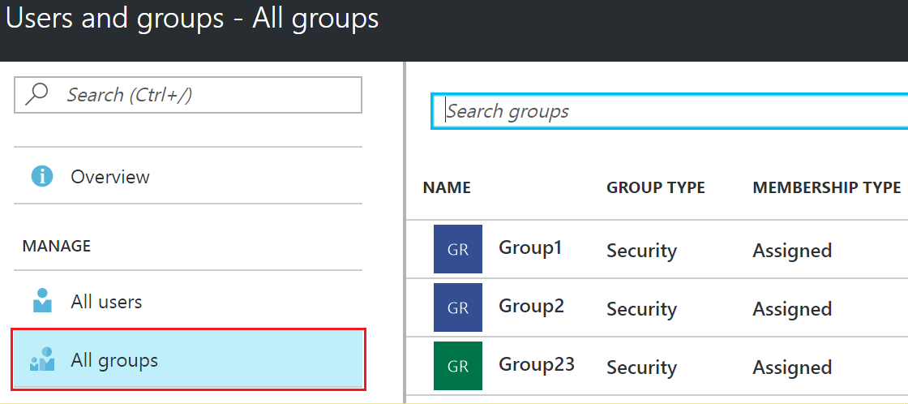
Group Accounts
Security groups
Distribution groups
Directly assigned
Dynamically assigned
New-AzADGroup -Description "Marketing" -DisplayName "Marketing" -MailEnabled $false -SecurityEnabled $true -MailNickName "Marketing"
Notes:
✔️ Have you given any thought to which groups you need to create? Would you directly assign or dynamically assign membership?

Slide 132
Adding Group Members
# Create a new group
New-AzADGroup -DisplayName Developers -MailNickname Developers
# Retrieve the group ObjectId
Get-AzADGroup –DisplayName Developers
# Retrieve the new member ObjectId
Get-AzADUser –DisplayName “Chris Green”
# Add the user to the group
Add-AzADGroupMember -ObjectId <group ObjectId> -RefObjectId <user ObjectId>
# Verify the members of the group
Get-AzADGroupMember -GroupObjectId <group ObjectId>

Slide 133
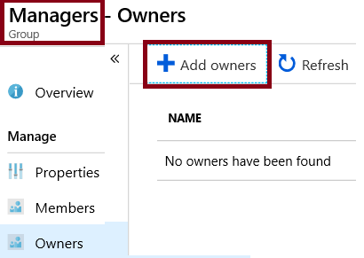
Adding a Group Owner
# Get the group ObjectId
Get-AzADGroup
# Get the owner (user) RefObjectId
Get-AzADUser
# Add the user as a group owner
Add-AzADGroupOwner -ObjectId <group ID> -RefObjectId <user ID>
# Verify group ownership
Get-AzADGroupOwner -ObjectId <group ID>

Slide 134
Demonstration – Users and Groups
Determine domain information
Explore user accounts
Explore group accounts
Explore PowerShell for group management
Notes:
✔ Always consider having students walk-through the demonstrations themselves. Also, consider the overlap with the formal labs and your best use of time.

Slide 135
Lesson 04: Azure Policy

Slide 136
Azure Policy Overview
Azure Policy
Implementing Azure Policy
Policy Definitions
Create Initiative Definitions
Scope the Initiative Definition
Determine Compliance
Demonstration – Azure Policy
Notes:
Lesson overview

Slide 137
Azure Policy
Azure Policy is a service in Azure that you use to create, assign and, manage policies
Azure Policy runs evaluations and scans for non-compliant resources
Advantages:
Enforcement and compliance
Apply policies at scale
Remediation
Notes:
For more information, you can see:
Azure Policy Documentation - https://docs.microsoft.com/azure/azure-policy/

Slide 138
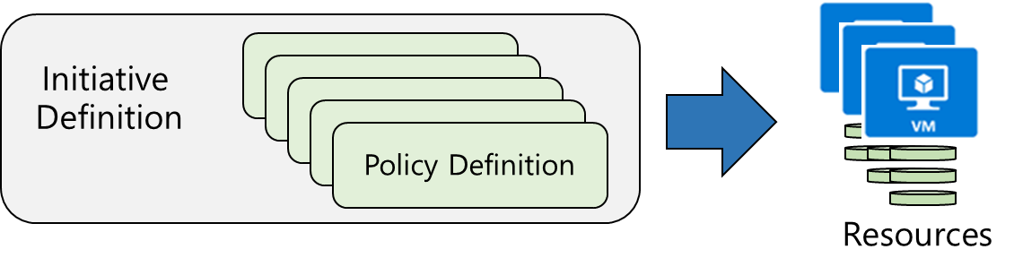
Implementing Azure Policy
Browse Policy Definitions
Create Initiative Definitions
Scope the Initiative Definition
View Policy evaluation results
Notes:
The next four topics step you through creating an Azure policy.
✔ Even if you have only a few Policy Definitions, we recommend creating an Initiative Definition.

Slide 139
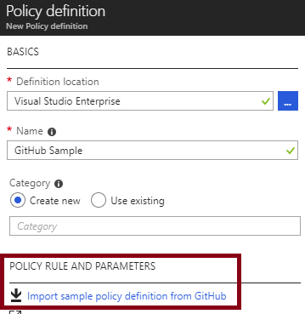
Policy Definitions
Many policy definitions are available
You can import policies from GitHub
Policy Definitions have a specific JSON format
You can create custom policy definitions
Notes:
✔️ Policy Definitions have a specific JSON format. As an Azure Administrator you will not need to create files in this format, but you may want to take a look so you are familiar. Review the available definitions in the portal and in GitHub.

Slide 140

Create Initiative Definitions
Group policy definitions
Include one or more policies
Requires planning
Notes:
✔️ Can you see how this will require some planning to organize your policies?

Slide 141

Scope the Initiative Definition
Assign the definition to a scope
The scope enforces the policy
Select the subscription, and optionally the resource group
Notes:
✔️ Currently, an Initiative Definition can have up to 100 policies.

Slide 142

Determine Compliance
Non-compliant initiatives
Non-compliant policies
Non-compliant resources
Notes:
✔️ Policy evaluation happens about once an hour, which means that if you make changes to your policy definition and create a policy assignment then it will be re-evaluated over your resources within the hour.

Slide 143
Demonstration – Azure Policy
Assign a policy
Create and assign an initiative definition
Check for compliance
Notes:
✔ Always consider having students walk-through the demonstrations themselves. Also, consider the overlap with the formal labs and your best use of time.

Slide 144
Lesson 05: Lab and Review Questions
Notes:
Pick the lab(s) most appropriate for your audience.

Slide 145
Lab – Role-Based Access Control
Adatum Corporation wants to use Azure Role Based Access Control and Azure Policy to control provisioning and management of their Azure resources. It also wants to be able to automate and track provisioning and management tasks.
Exercise 1. Configure delegation of provisioning and management of Azure resources by using built-in Role-Based Access Control (RBAC) roles and built-in Azure policies.
Exercise 2. Verify delegation by provisioning Azure resources as a delegated admin and auditing provisioning events.
Lab time: 60 minutes

Slide 146
Lab: Governance and Compliance
Adatum Corporation wants to use Azure policies and initiatives in order to enforce resource tagging in its Azure subscription. Once the environment is compliant, Adatum wants to prevent unintended changes by implementing resource locks.
Exercise 1. Implement Azure tags by using Azure policies and initiatives
Exercise 2. Implement Azure resource locks
Lab time: 60 minutes

Slide 147
Module Review Questions
Notes:
As you have time go through the Module Review questions in the student materials.

